Slide 1
Performance analysis framework for base station placement using IEEE 802.11
Group study presentation
18.03.2020
Kirill Kukartsev
Zufar Makhmutov
Rustam Khakov
Notes:
Kirill

Slide 2
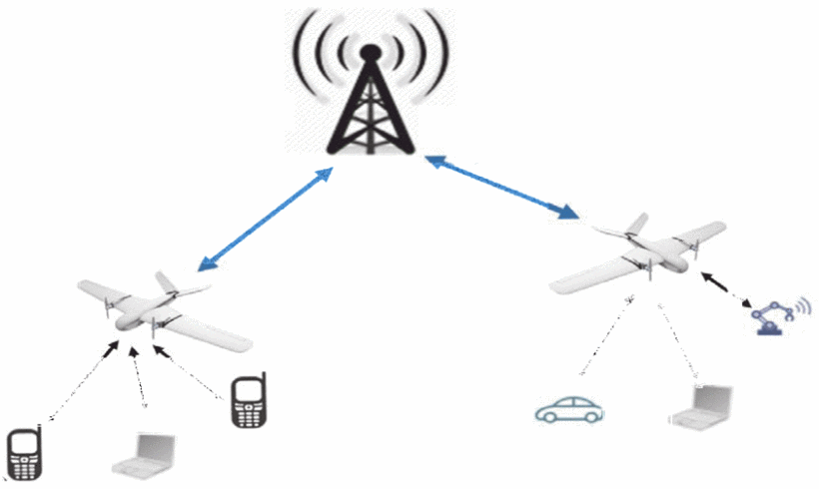
Problem Description
Mobile users’ demand increasing
Higher speed, lower latency
More data and services
Tendency to be located closely to users
2G: Macro-cells
3G - 4G: Micro-cells
5G: Pico-cells
Idea: Unmanned Aerial Vehicle with Base Stations (UAV-BS)
Problems:
How to design a placement algorithm?
How to evaluate correctness the algorithm?
How to test the algorithm in the real life?
How to coordinate the elements of mobile communication system infrastructure?
Increasing coverage and capacity
with UAV equipped with base stations, source
Notes:
Kirill

Slide 3
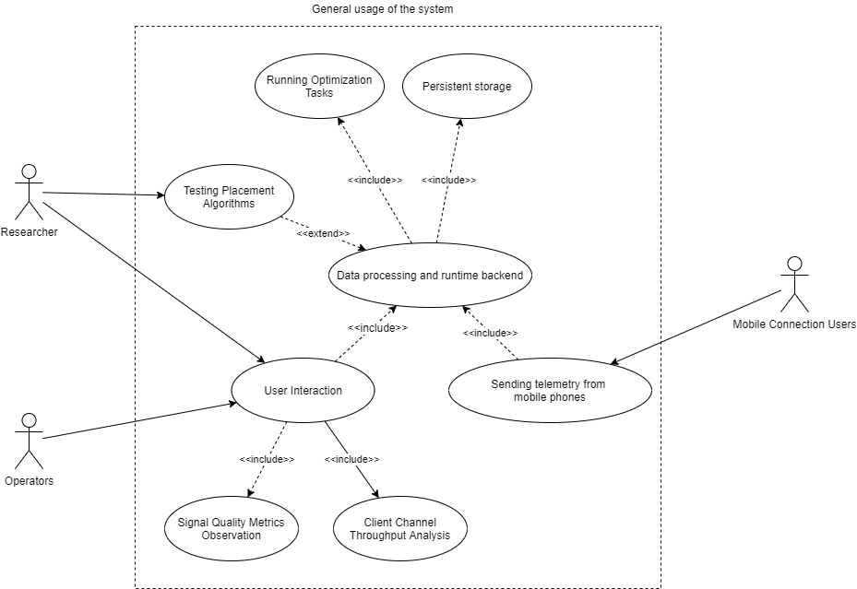
A general use-case for possible solution
A generalized use-case for a placement algorithm experimental framework
Notes:
Kirill

Slide 4
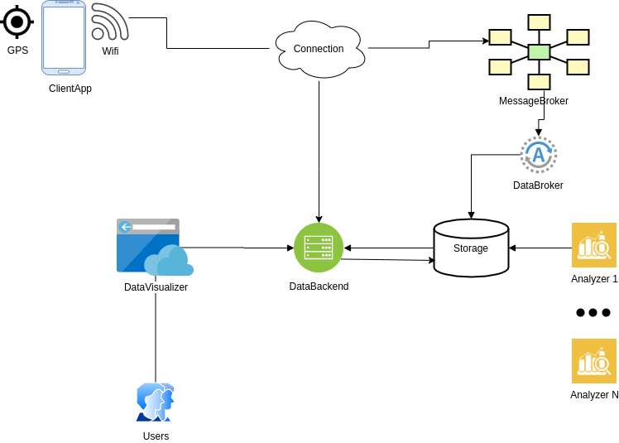
Abstract System Design
Abstract Design for component interaction for the given possible problem solution
Notes:
Rustam

Slide 5
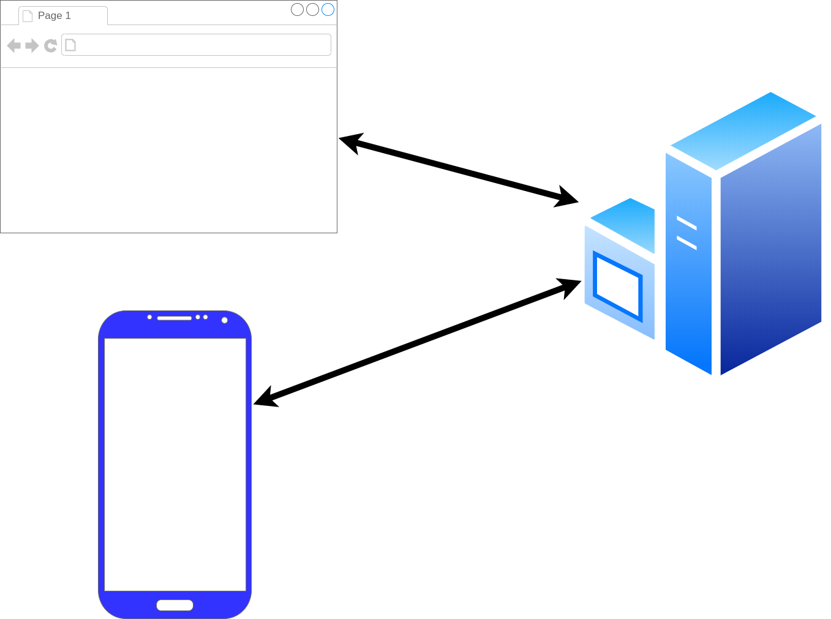
Framework Architecture Description
GPS_Frontend
GPS_Tracker
GPS_Android
Three main component of framework: a phone (GPS_Android), user interface (GPS_Frontend), data processing (GPS_Tracker)
Notes:
Rustam

Slide 6
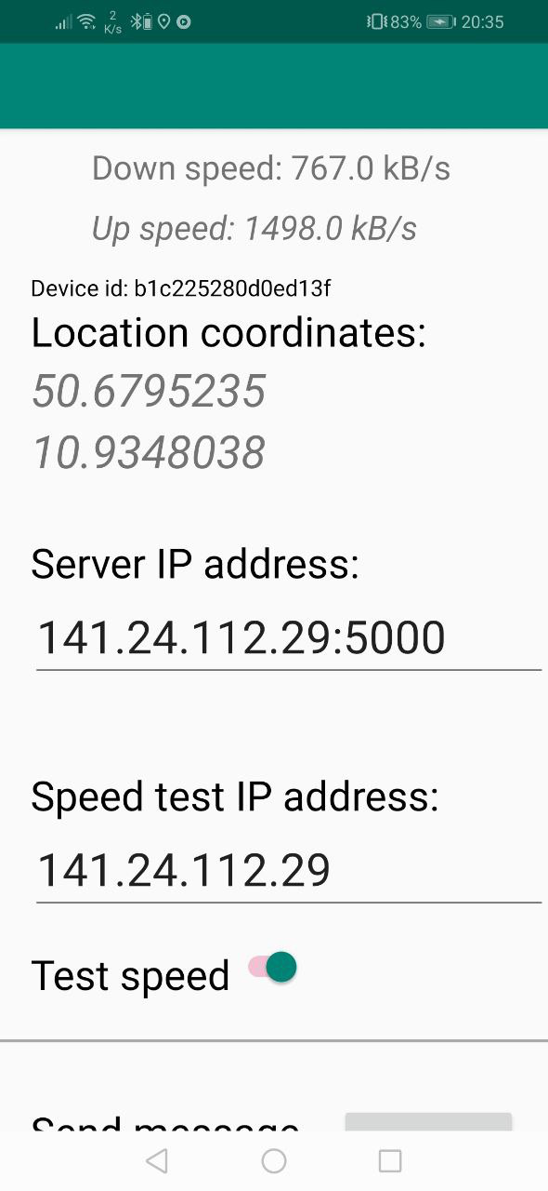
Android Component
Measure:
GPS location
Wifi connection
Connection speed using given server by MQTT or HTTP
Activities:
Send measurment result to given server
Measure data periodicaly with given timeout on background
GPS_Android installed on an Android SmartPhone
Notes:
Rustam

Slide 7
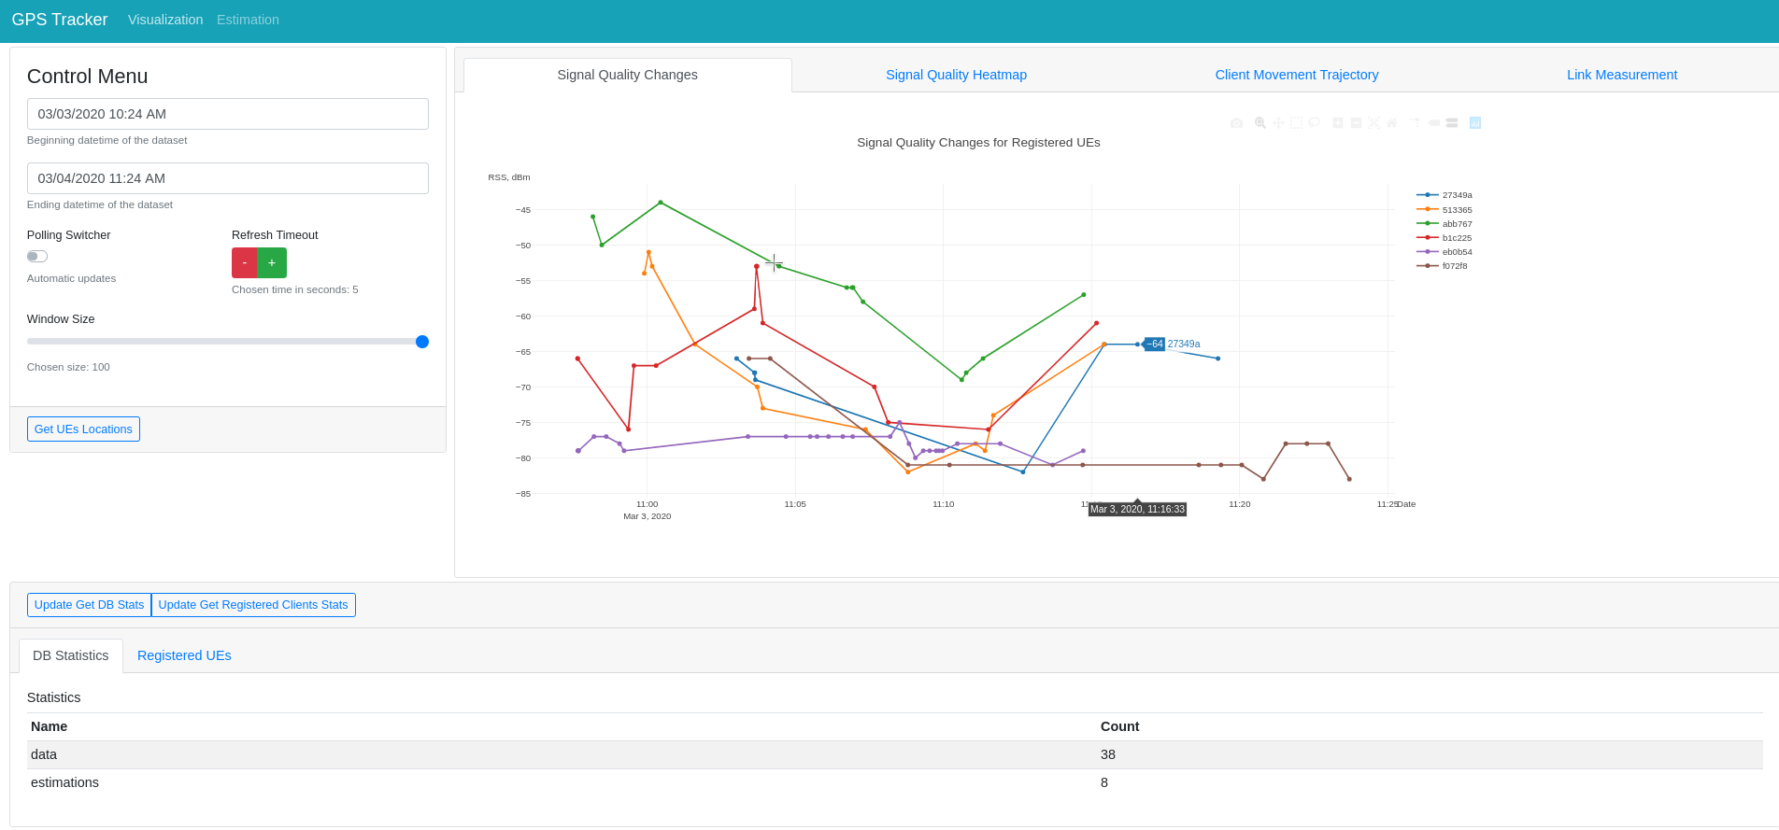
UI Component
Timeframe,
update
frequency
configuration
Location data on given
timeframe
Database
statistics
Layout of the UI implemented by GPS_Frontend. The user interact via a web-browser.
Notes:
Rustam

Slide 8
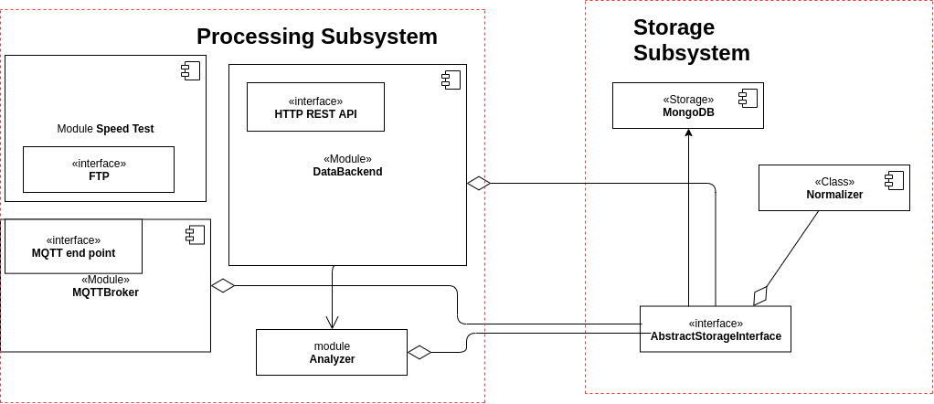
Backend Component
Component diagram for GPS_Tracker backend components.
Notes:
Rustam

Slide 9
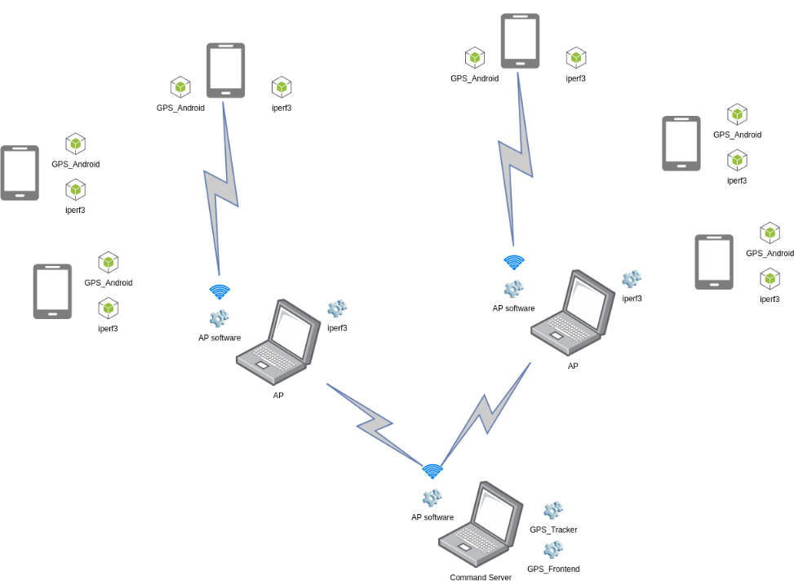
Component Layout for Experiment
Communication between components during the experiment
Notes:
Zufar

Slide 10
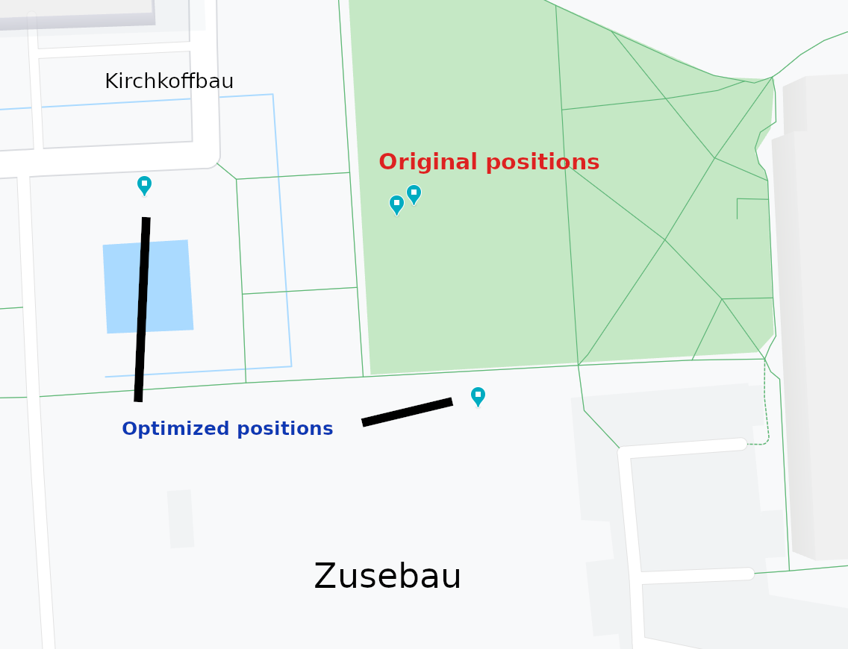
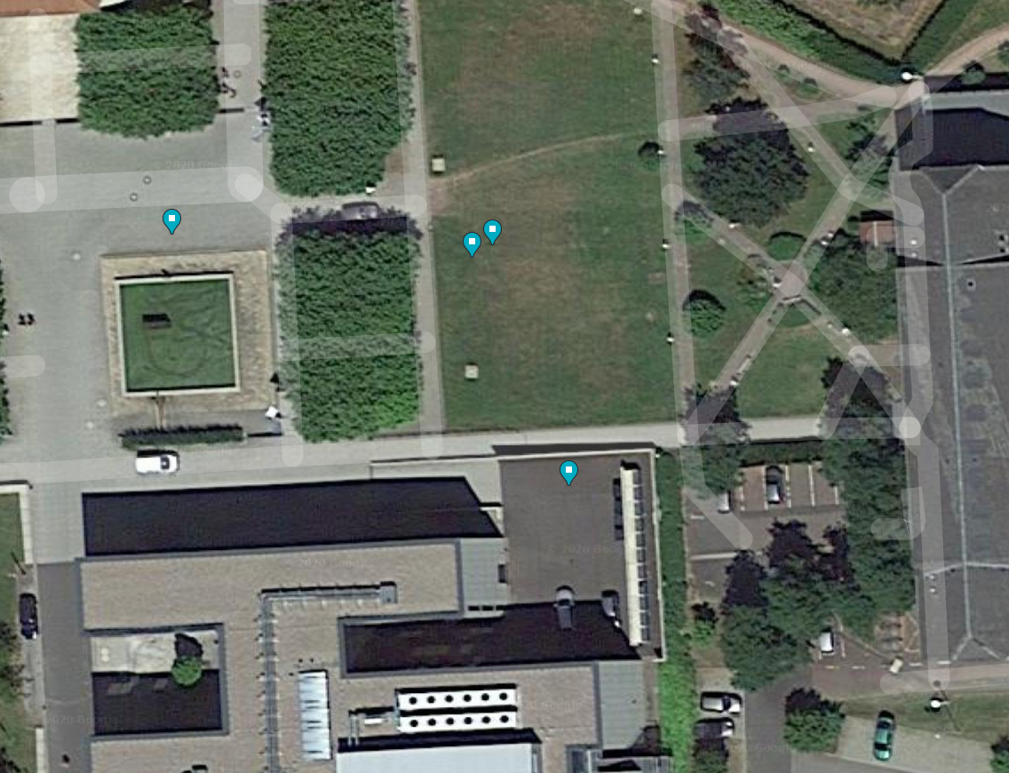
Optimized positions for UAV-BS
Logical map for the original position and suggested optimized position. Coordinates by “clustering” (K-Means) position optimization algorithms are highly biased.
Satellite map with original and suggested positions for UAV-BS layout
Notes:
Zufar

Slide 11
Result of experiment
Are the initial aims fulfilled?
 | Aspect | Result
Developed system | Functional properties | Works as expected, but had to alter architecture
 | Stability / Performance / Usability | Link may suffer collisions
Optimization algorithm | Provided positions | Calculated correctly
 | Stability / Performance / Usability | Extra data and/or other algo for higher accuracy
Result of 4 performed experiments
Notes:
Zufar

Slide 12
Conclusion
Good overall results
Applicable for UAVs layout optimization
Capability to analyze the measured data
Ability to be highly modified to obtain more reliable results.
Extensibility of the platform
But …
Framework architectural problem and nuances
Behavior of components are hard to model in the laboratory, but real experiment is exhausting.
Embedded algorithms have restrictions
The algorithms are simplified and produce biased results
Notes:
Zufar

Slide 13
Appendix. Resolved problems
Table describes significant moments of workflow
Problem | Group | Resolved way
Can’t install app via apk | Android | Install using Android Studio
Data doesn’t come to CnC | Wi-Fi | Check AP
Silent crash of app | Android | Added logging to file in phone
Error related to MQTT | Software | Replace MQTT with HTTP
Hard to describe software architecture | Report | Refactor code to follow MVVM pattern
Notes:
Zufar

Slide 14
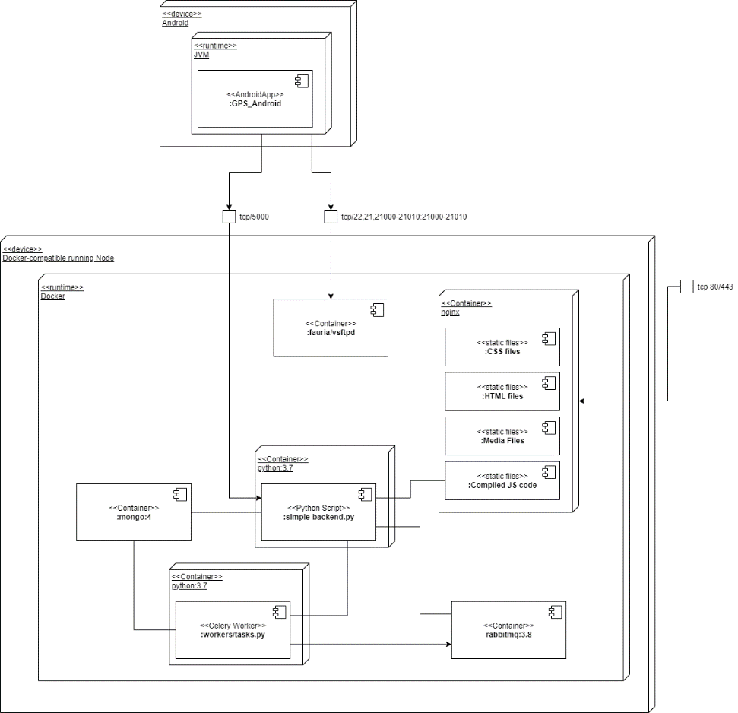
Appendix. Deployment Diagram of Framework
Dockerized infrastructure
Unified interface
Configuration in .config or OS env
A deployment case in container runtime.
Notes:
Kirill

Slide 15
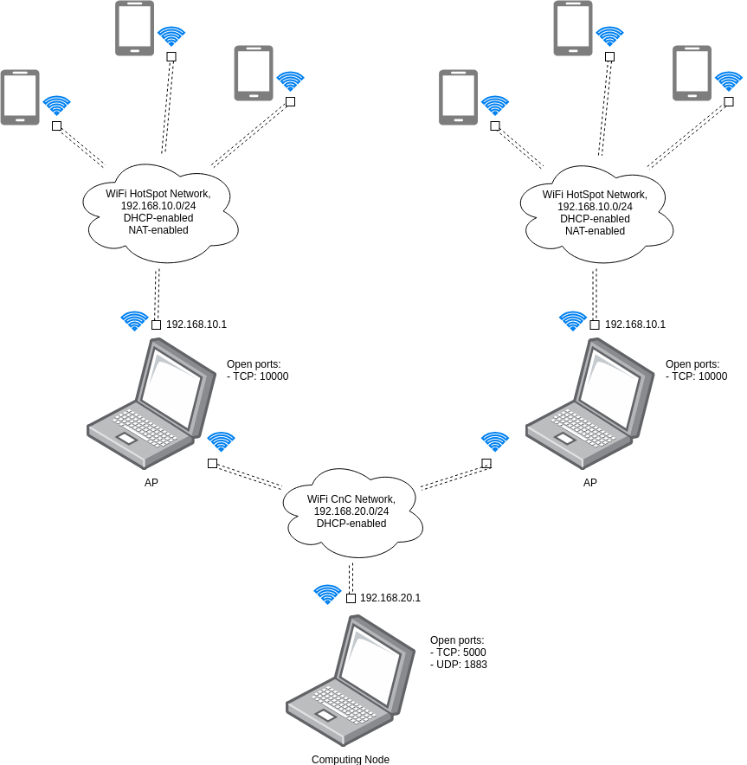
Appendix. Network Diagram of Experiment
A network scheme of experiment
Notes:
Kirill

Slide 16
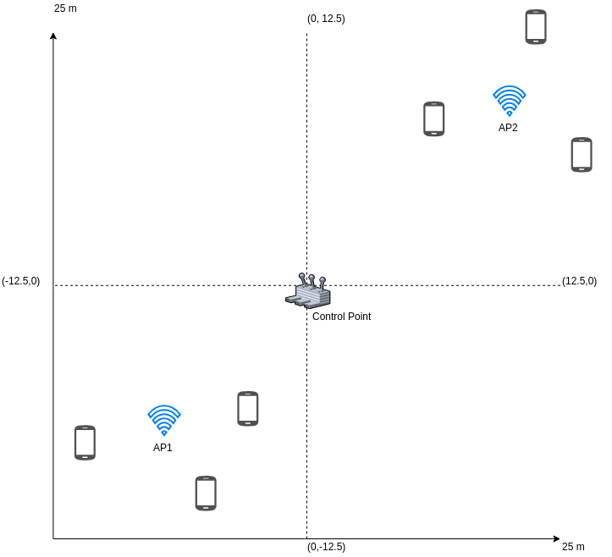
Appendix. Experiment 1/6
Experiment Case 2 – Sub-Optimal Case
Notes:
Zufar

Slide 17
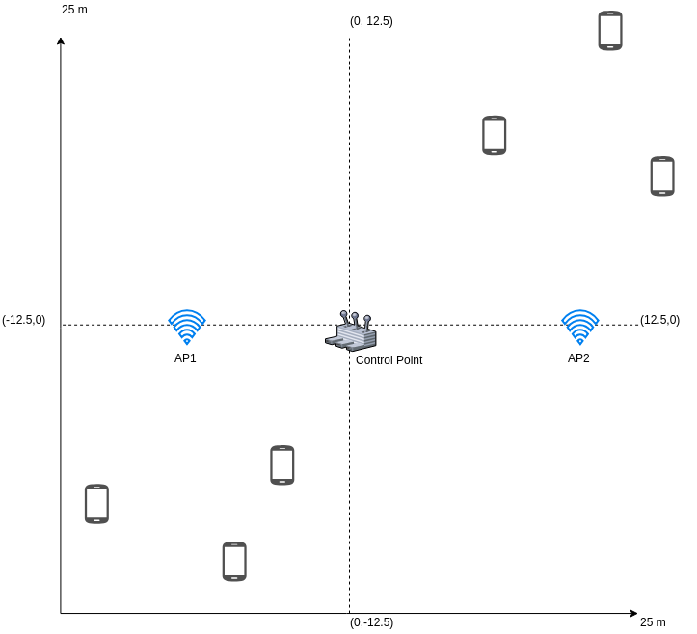
Appendix. Experiment 1/6
Experiment Case 1 – Uniform Case
Notes:
Zufar

Slide 18
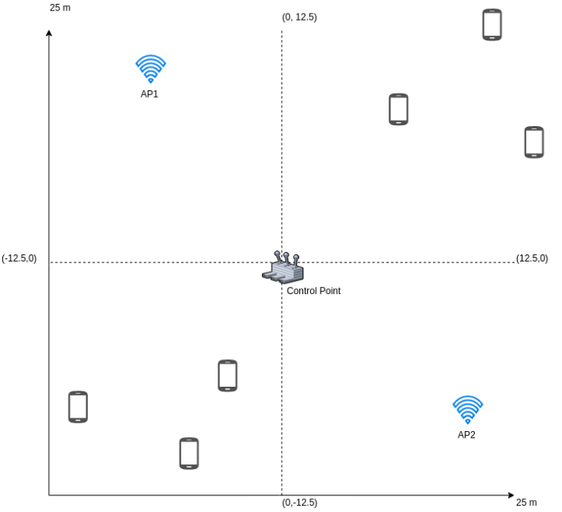
Appendix. Experiment 1/6
Experiment Case 1 – Near- Uniform Case
Notes:
Zufar

Slide 19
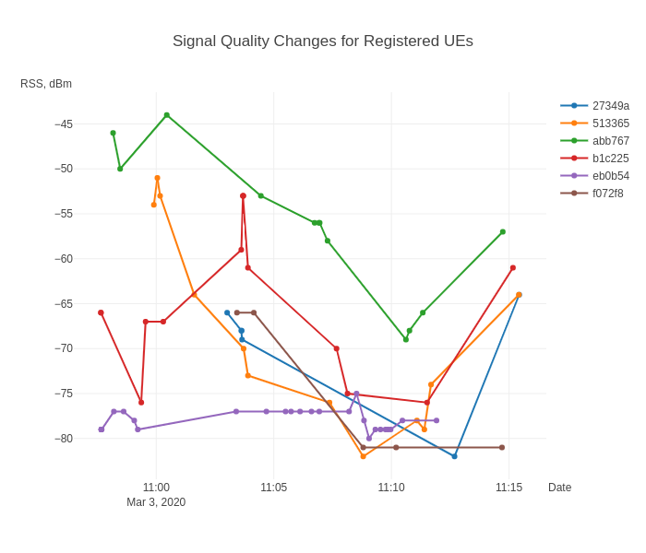
Appendix. Experiment 2/6
Overall Signal Quality (RSS) changes during the experiment.
Notes:
Zufar

Slide 20
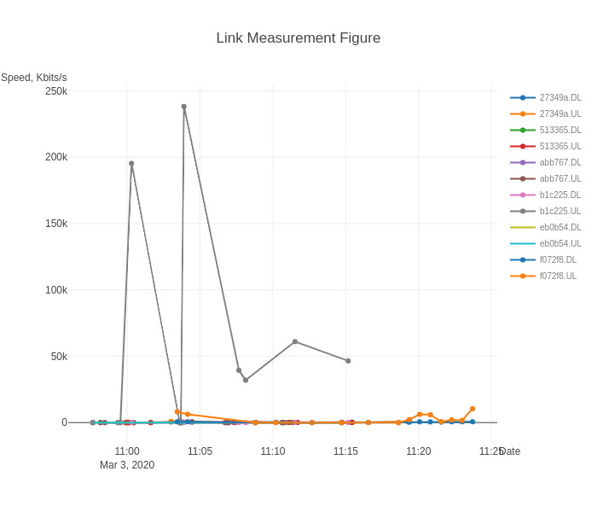
Appendix. Experiment 3/6
Measured signal link speed for uplink and downlink. Mostly metrics are degraded, cannot truly rely on them.
Notes:
Zufar

Slide 21
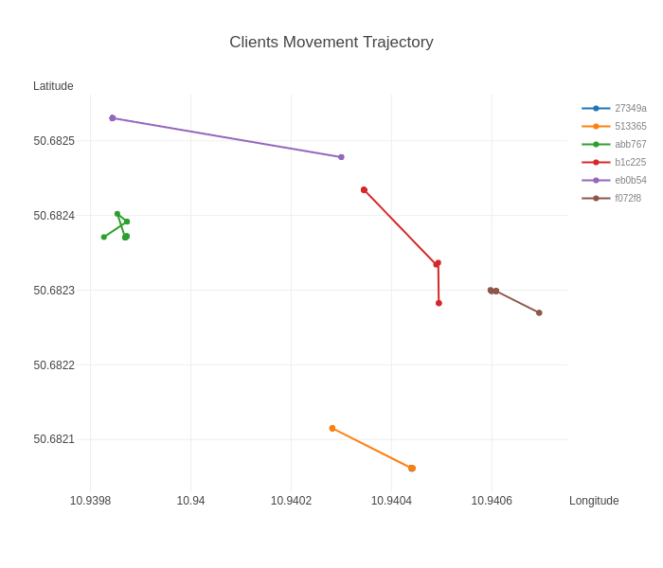
Appendix. Experiment 4/6
Overall detected coordinates changes during the experiment. Clearly shown that GPS has measurement error.
Notes:
Zufar

Slide 22
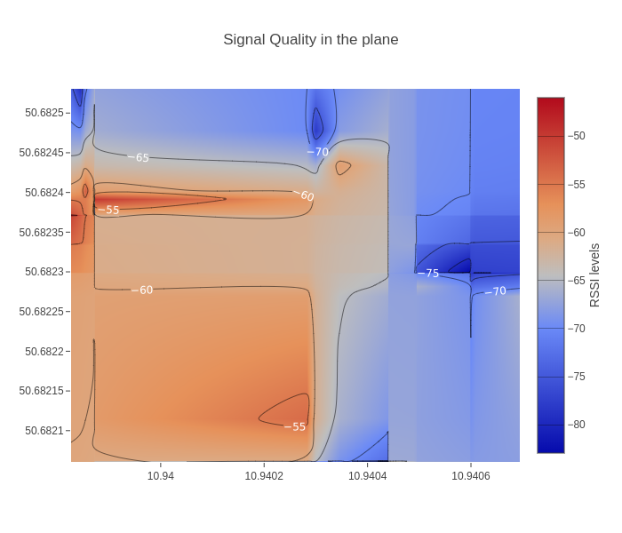
Appendix. Experiment 5/6
The heatmap of quality of WI-FI signal by GPS coordinates.
Notes:
Zufar

Slide 23
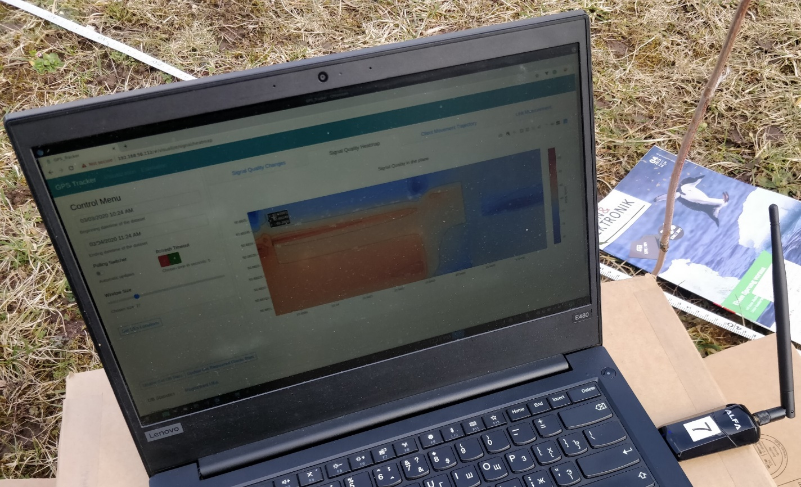
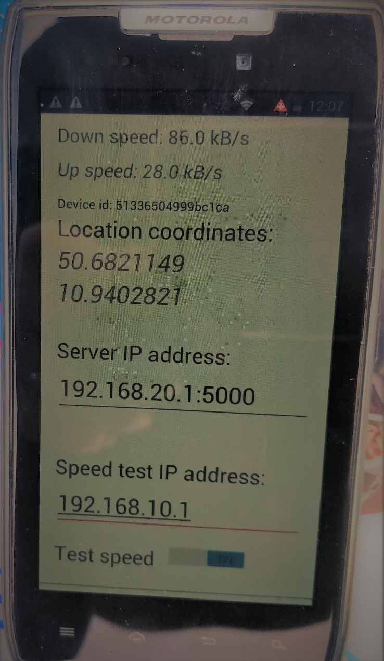
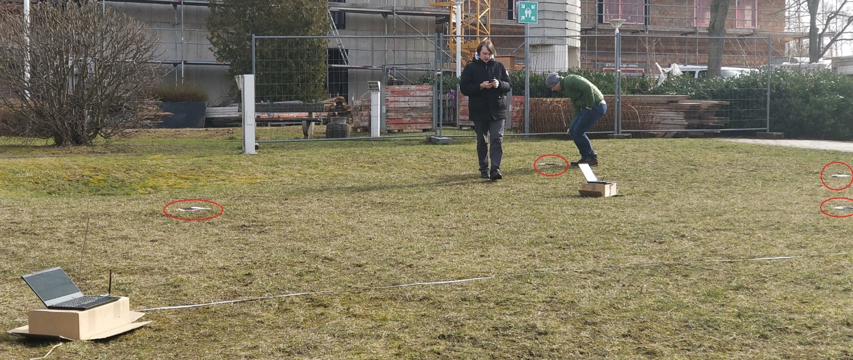
Appendix. Experiment 6/6
Notes:
Zufar

